Slide 1
Paytm UPI Fraud Surveillance
M.Tech Internship Project
Department of Data Engineering
Presented by:Saima Anjum

Slide 2
Introduction
• UPI has become the most popular digital payment system in India.
• Increasing online transactions have also increased fraud attempts.
• Machine learning can identify suspicious transaction patterns in real time.

Slide 3
Problem Statement
• Traditional rule-based systems cannot detect every fraud.
• Fraudsters continuously change their attack patterns.
• A smarter fraud detection mechanism is required.

Slide 4
Project Objectives
• Detect fraudulent UPI transactions.
• Reduce financial loss.
• Improve customer security.
• Provide real-time prediction.
• Build a scalable surveillance prototype.

Slide 5
System Architecture
Data Sources
↓
Dataset Generation
↓
Random Forest / XGBoost Training
↓
Saved ML Model (.pkl)
↓
Streamlit Dashboard
↓
Fraud Prediction

Slide 6
Methodology
1. Generate synthetic dataset.
2. Train Random Forest and XGBoost models.
3. Save trained models.
4. User enters transaction details.
5. Model predicts Normal or Fraud.

Slide 7
Technology Stack
• Python
• Pandas
• Scikit-learn
• Random Forest
• XGBoost
• Streamlit
• Joblib

Slide 8
Input Features
• Transaction Amount
• Transaction Velocity
• Location Risk
• Device Change
These features are used by the ML model to classify transactions.

Slide 9
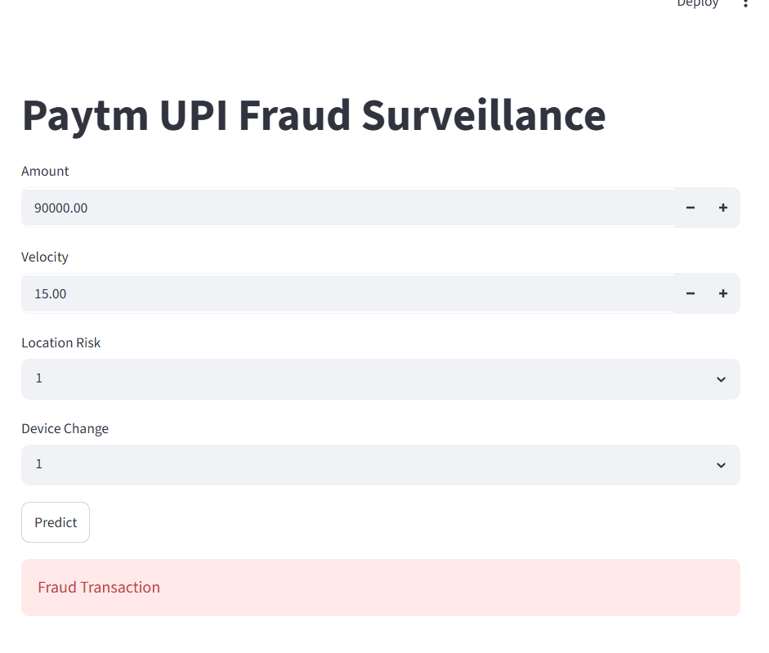
Working Demo
Demo Highlights
• Interactive UI
• Real-time prediction
• Fraud detected successfully

Slide 10
Results
• Normal transactions are correctly identified.
• Suspicious transactions are classified as fraud.
• Interactive dashboard provides instant prediction.

Slide 11
Future Enhancements
• Apache Kafka
• Apache Flink
• PostgreSQL
• FastAPI
• Live alerts
• Real-time analytics
• REST API

Slide 12
Conclusion
• Developed a working ML-based fraud detection prototype.
• Demonstrated successful fraud prediction.
• Proposed architecture supports future real-time deployment.
Thank You

